Slide 1

Fraud Detection
in Electricity and Gas Consumption
for STEG, Tunisia.
Rahul George
Otto Schmal
27 January, 2025

Slide 2

Overview
Business Goal
Data Source
EDA
Data Cleaning
Feature Engineering
Base Line Model
Final Model
Future Work

Slide 3
Business Goal
Build a model to identify fraudulent meter usage to reduce revenue loss.
Using the client’s billing history to detect and recognize clients involved in fraudulent activities.
600,000 euros loss.

Slide 4
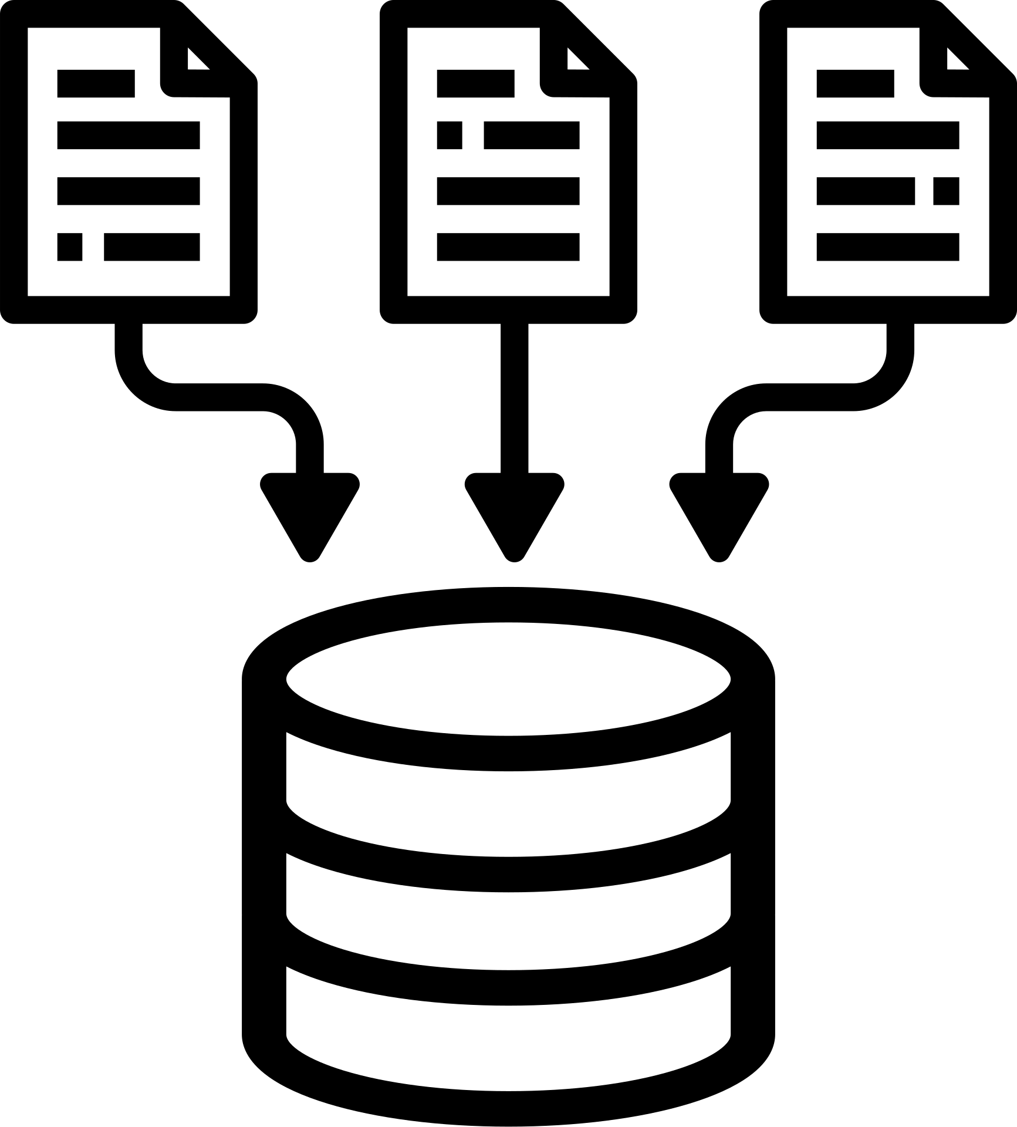
Data Source
2 different tables:
Client data (demographic and fraud labels)
135.5K clients
Invoice data (invoices from 2005 - 2019)
+ 4M invoices
Challenges:
Imbalanced data
94% Not Fraud
6% Fraud
Large dataset volume

Slide 5
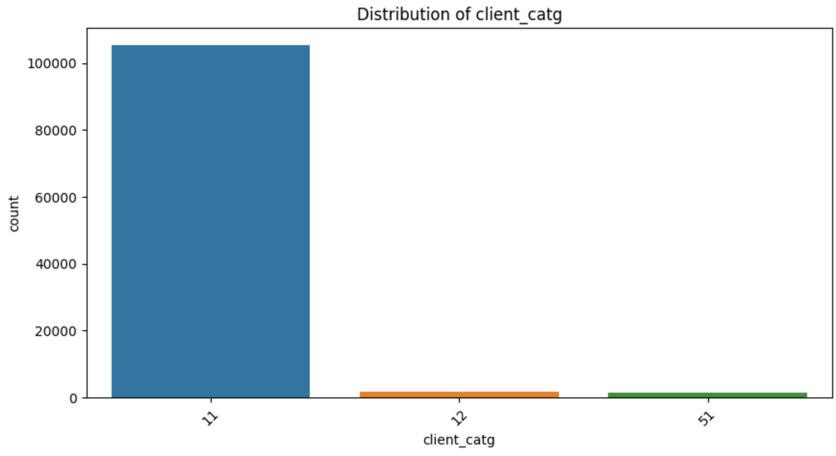
EDA (Exploratory Data analysis)
Distribution by Client Category

Slide 6
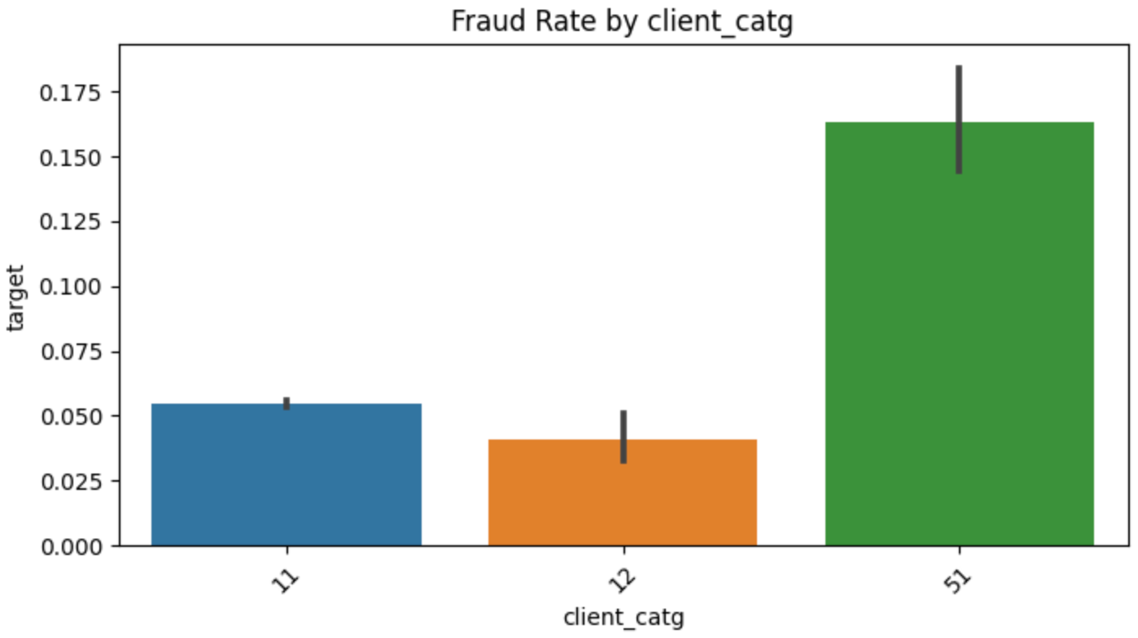
EDA (Exploratory Data analysis)
Fraud Rate by Client Category

Slide 7
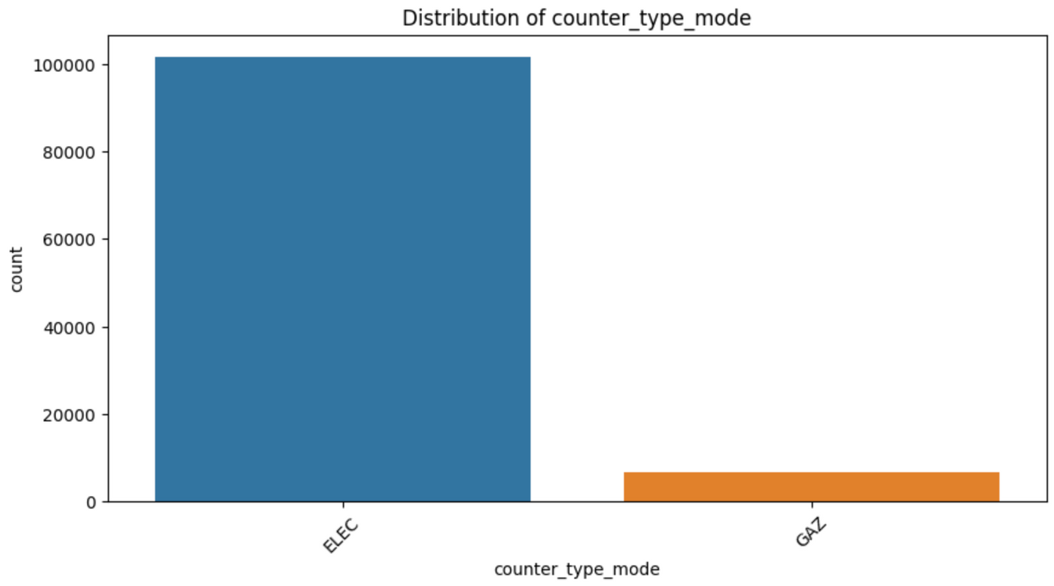
EDA (Exploratory Data analysis)
Distribution by type of Service

Slide 8
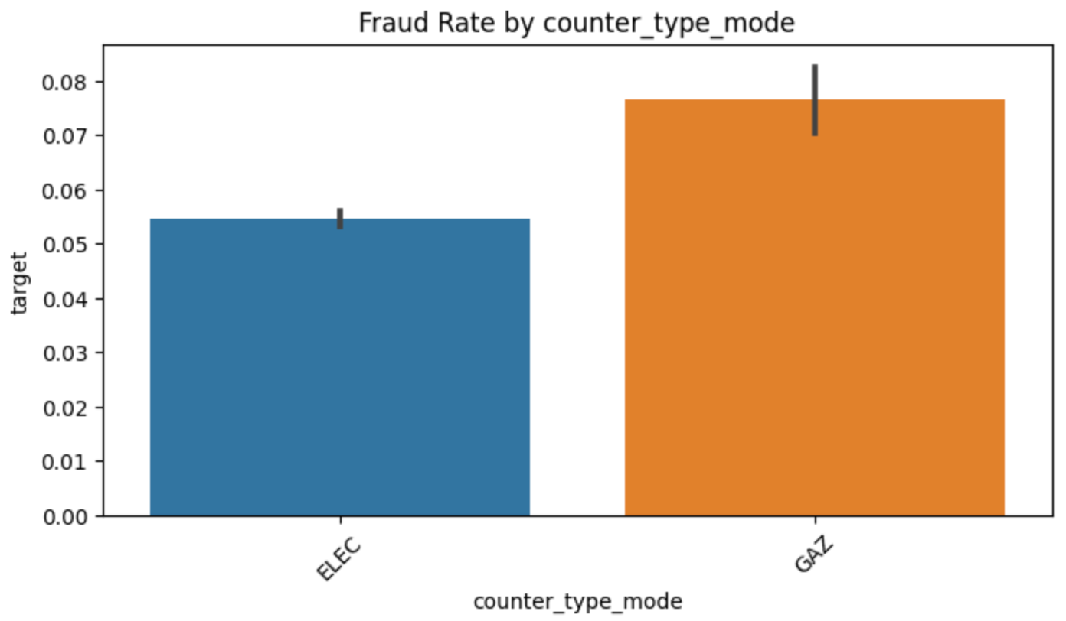
EDA (Exploratory Data analysis)
Fraud Rate by type of Service

Slide 9

Data Cleaning
Categorical Data
Aggregate by Mode
Entire Training Data Set
Summarizing the data
SMOTE TOMEK
Numerical Data
Aggregate by Mean and Standard Deviation

Slide 10
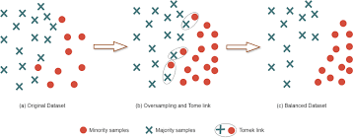
SMOTE TOMEK

Slide 11


Feature Engineering
New Features creation
Existing features
Bill count
Difference index
Frequency of billing
Categorical features
One Hot Encoding (OHE)
Numerical features
Standard scaling (If applicable)

Slide 12
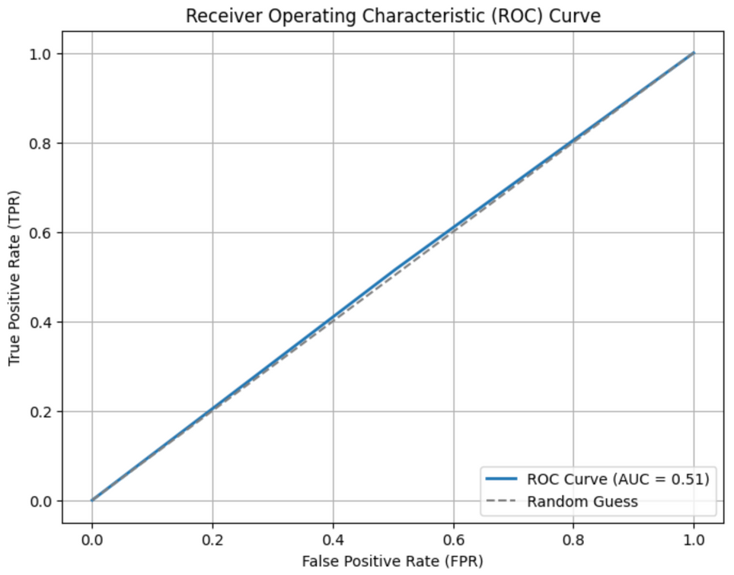
Base Line Model
Not Fraud
Misclasified as Fraud
12,713
( 49% )
12,873
( 51% )
734
( 49% )
773
( 51% )
Dummies Classifier
Misclasified as Not Fraud
Actual Fraud
ROC-AUC of 0.505
Confusion Matrix
Recall: 0.515

Slide 13
Final Model
Not Fraud
Misclasified as Fraud
20,656
( 80.94% )
4,930
( 19.06% )
Clouseau (XGBoost)
First Test
Tuning The Model
Optimising the Threshold
ROC-AUC: 0.66
Models preformance
745
( 49.23% )
768
( 50.22% )
Better at catching complex patterns
Handel larger data set more efficiently.
Requires more tuning and computation.
Error analysis
Detects half of the True Fraudulent cases.
19.06 % misclassified as fraud.
Misclasified as Not Fraud
Actual Fraud
Confusion Matrix

Slide 14
Comparison for choosing Final Model
Not Fraud
Misclasified as Fraud
Not Fraud
Misclasified as Fraud
12,886
( 50.36 % )
12,720
( 49.64% )
20,656
( 80.94% )
4,930
( 19.06% )
745
( 49.23% )
768
( 50.22% )
293
( 19.36% )
1,220
( 80.64% )
Misclasified as Not Fraud
Actual Fraud
Misclasified as Not Fraud
Actual Fraud
Confusion Matrix XGBoost
Confusion Matrix Logistic Regresion

Slide 15
Future work
Feature selection
Stacking
Hyper parameters tuning

Slide 16
Questions?

Slide 17
Thank you

